Slide 1


Radiologium

Slide 2
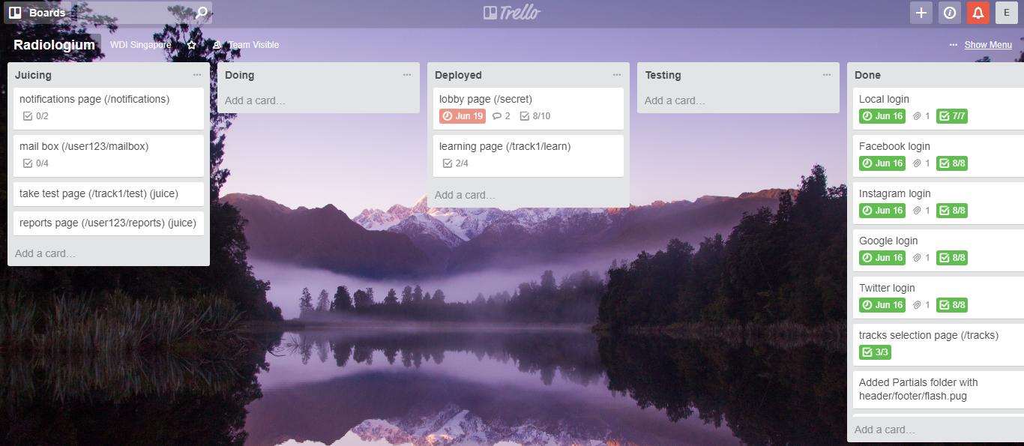

Slide 3
Radiologium
MVP Basic Features
Social Media Logins
Local Login
Local Signup
Logout
Delete Account
Display Tracks
Update local profile
Lesson Node (20%)

Slide 4
Problems Encountered
Mongoose Update
App.js, passport, Router, Controller, callback functions
Back-end--Front-end + referencing from other database tables + validation

Slide 5
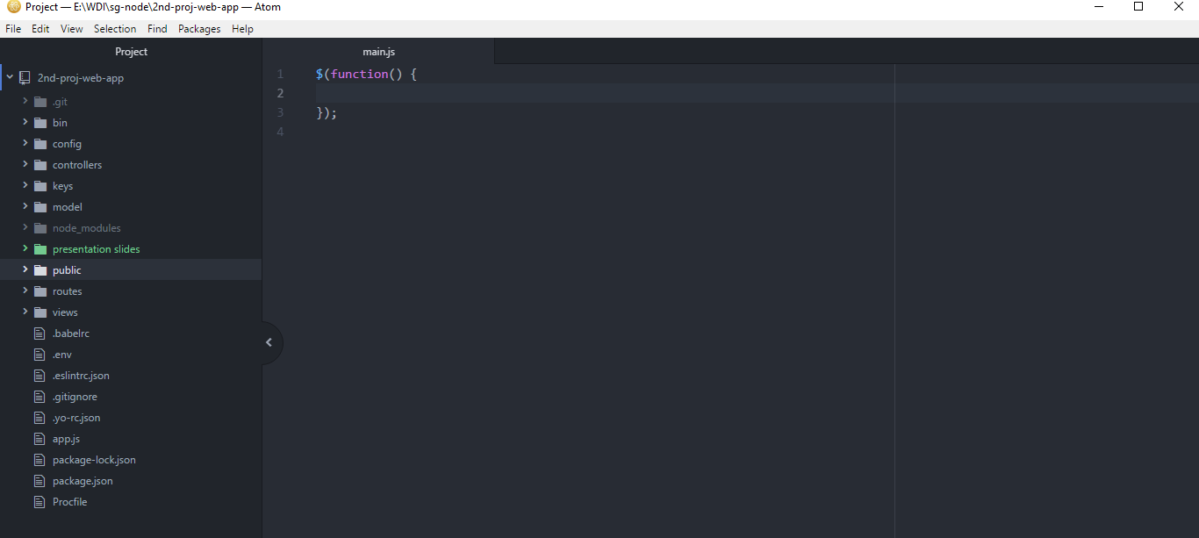

Slide 6
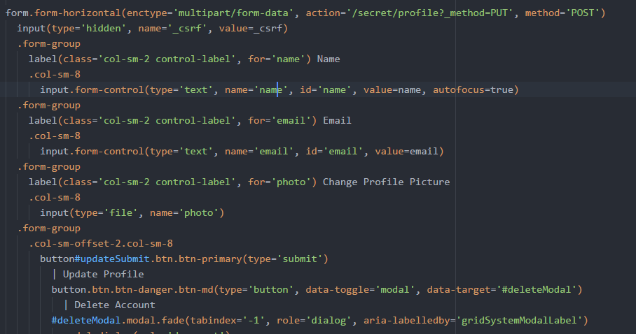
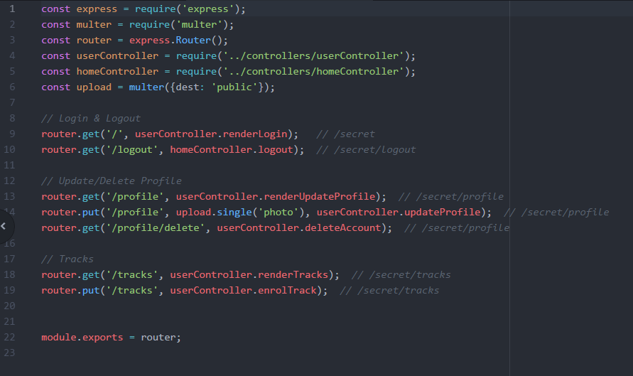

Slide 7

Go to radiologium site

